Slide 1



Slide 2
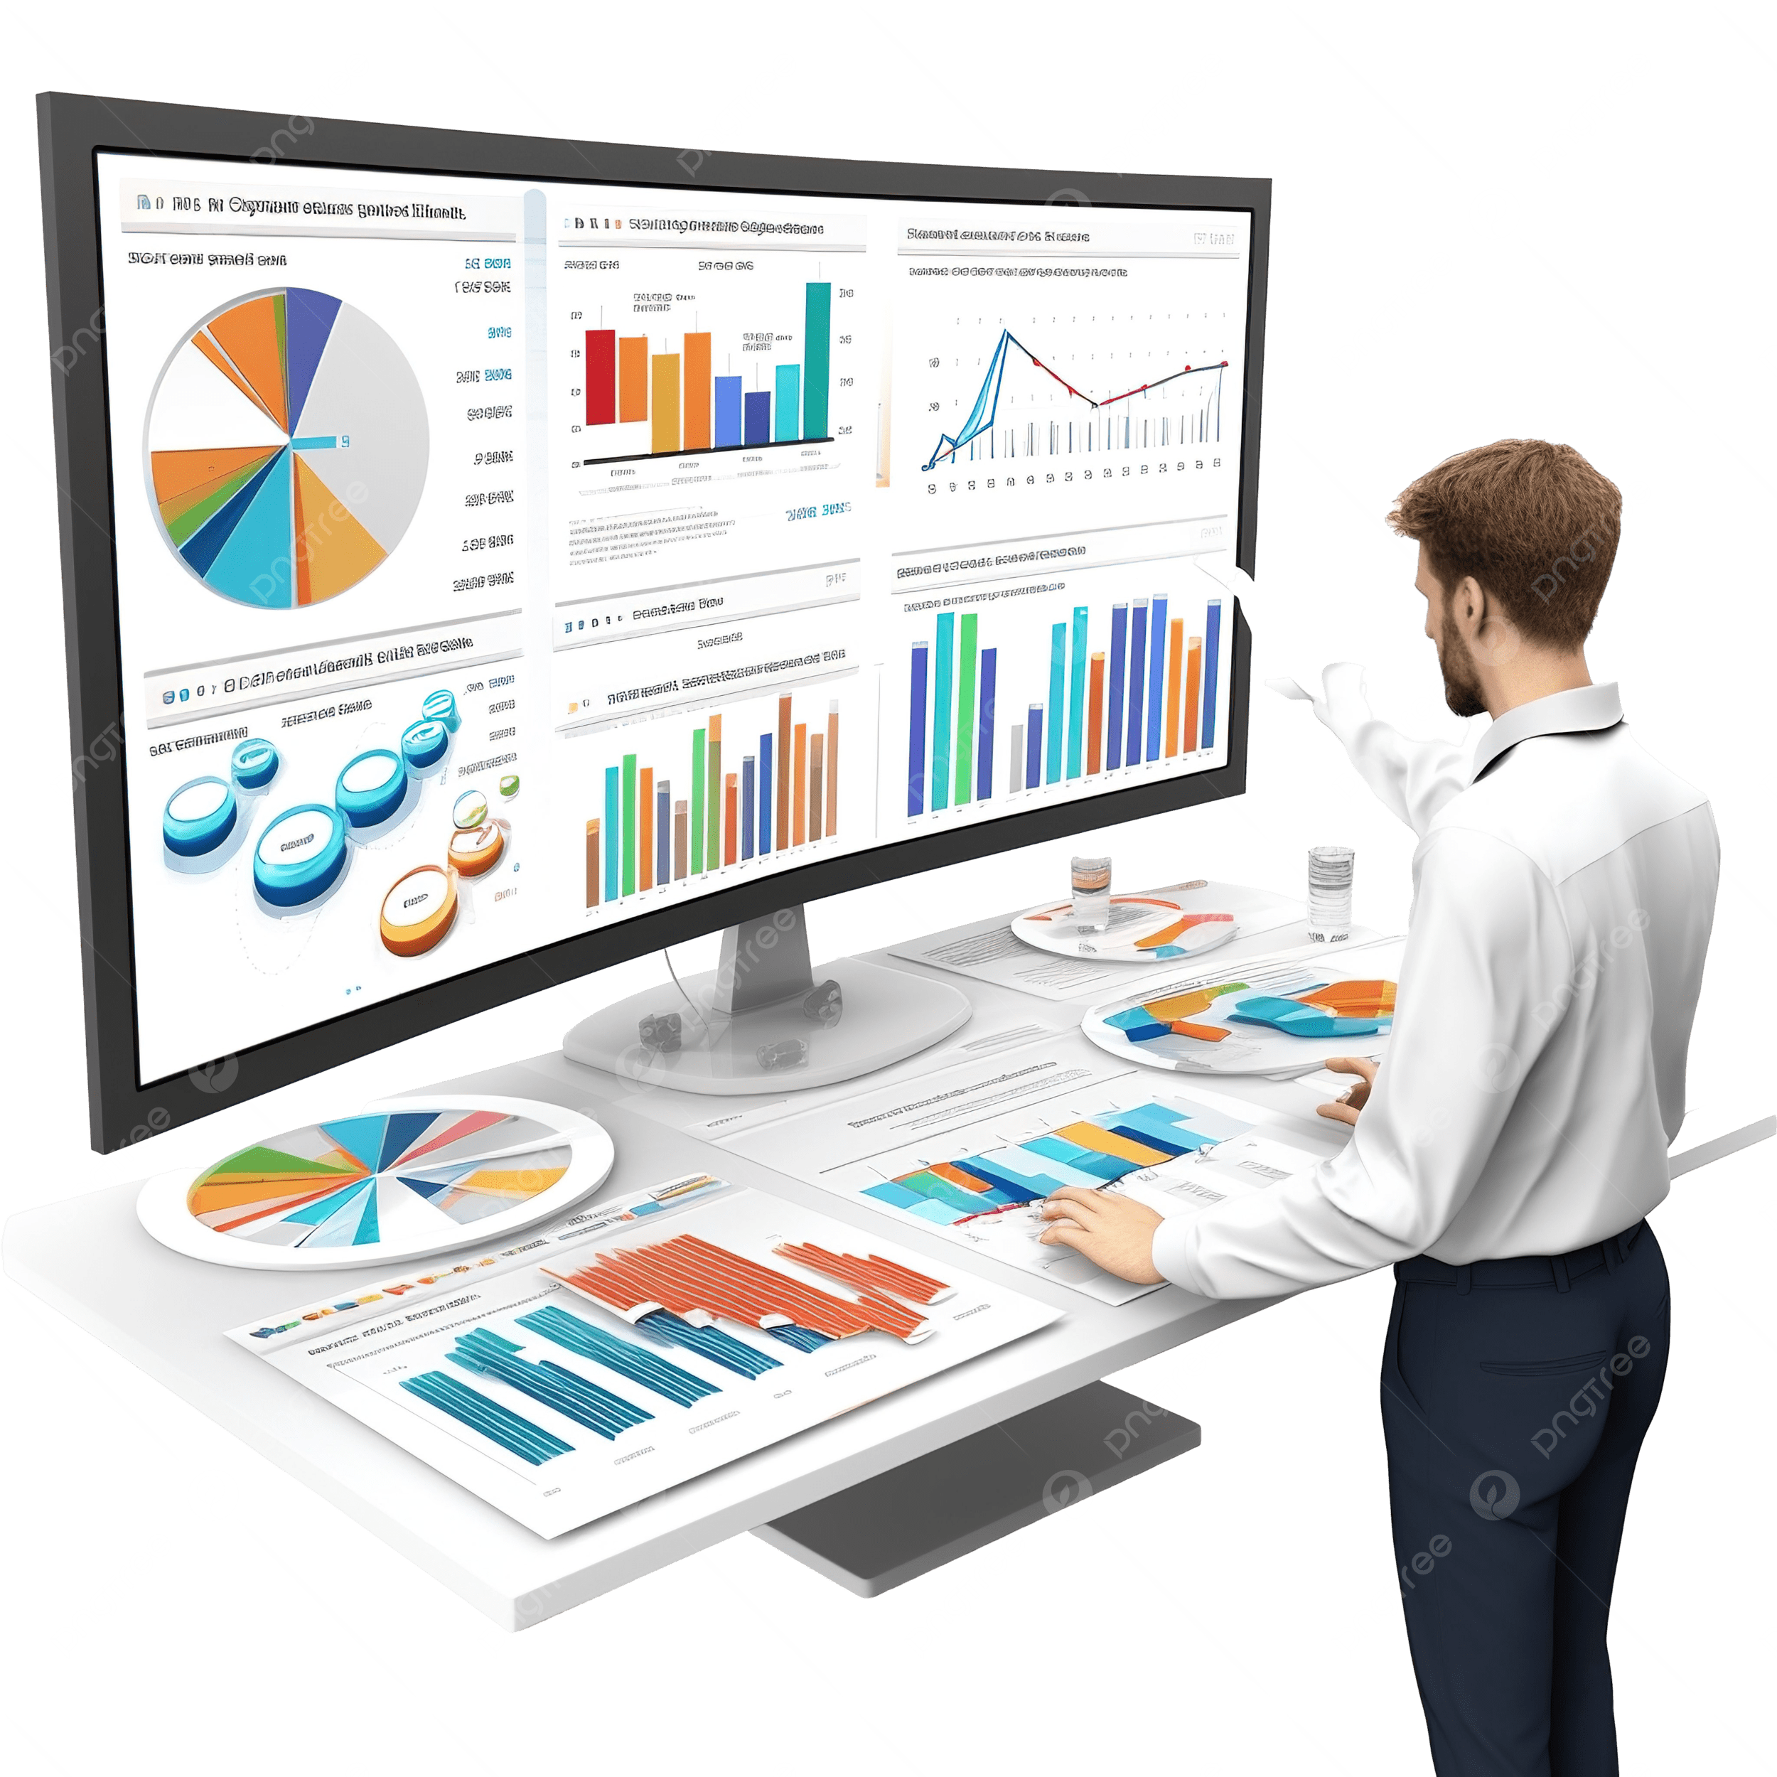
BUSINESS ANALYTICS Introduction to Business Analytics and Core Business Functions
BUSINESS ANALYSIS KPIs and Metrics

Slide 3
Learning Objectives – WEEK 10
By the end of today you should be able to:
Understand what KPIs and metrics are
Design meaningful KPIs for real businesses
Differentiate operational vs strategic KPIs
Identify good vs bad KPIs
Connect KPIs to business decisions
If you can’t measure it, you can’t improve it.

Slide 4
Previous Week - 9
Last week we learned:
✔ Descriptive = What happened ✔ Diagnostic = Why it happened ✔ Predictive = What will happen ✔ Prescriptive = What to do
Now:
👉 Analytics needs metrics to work.
Without KPIs → No measurement → No decisions
Example
Week 9:
We analyzed delivery delays.
Week 10:
👉 What metric tells us delivery is improving?
Answer:
Delivery Time KPI.

Slide 5
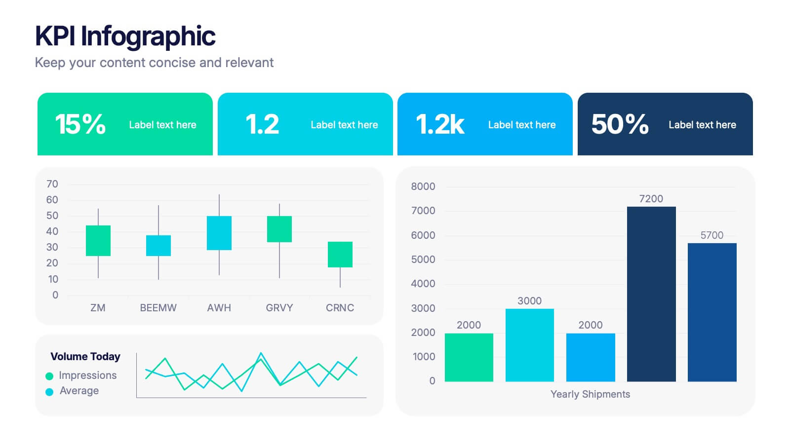
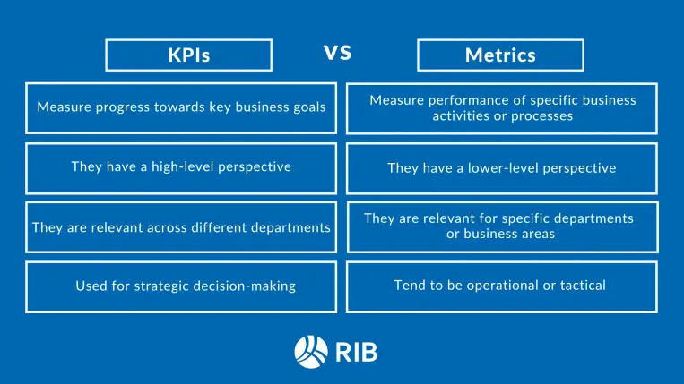
WHAT IS METRIC VS KPI?
📊 Metric
Any measurable value.
Example: Number of app downloads.
🎯 KPI (Key Performance Indicator)
A critical metric tied to business goals.
Example: Conversion rate (users who actually place order).
👉 “Is number of website visitors always a KPI?”
All KPIs are metrics, but not all metrics are KPIs.

Slide 6
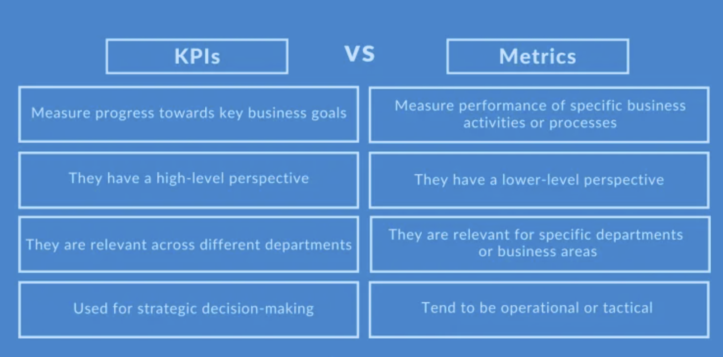

Slide 7
TYPES OF KPI
📈 1. Strategic KPIs (High-Level)
Explain:
Measure long-term business success.
🇵🇰 Example
Bank:
Revenue growth
Customer base increase
🌎 Example
Amazon:
Annual revenue
Market share
Strategic KPIs = “Big Picture”

Slide 8
TYPES OF KPI
⚙️ 2. Operational KPIs (Day-to-Day)
Explain:
Measure daily performance.
🇵🇰 Example
Careem:
Ride completion time
Driver availability
🌎 Example
Uber:
Avg ride wait time
Cancellation rate
Operational KPIs = “Daily performance”

Slide 9
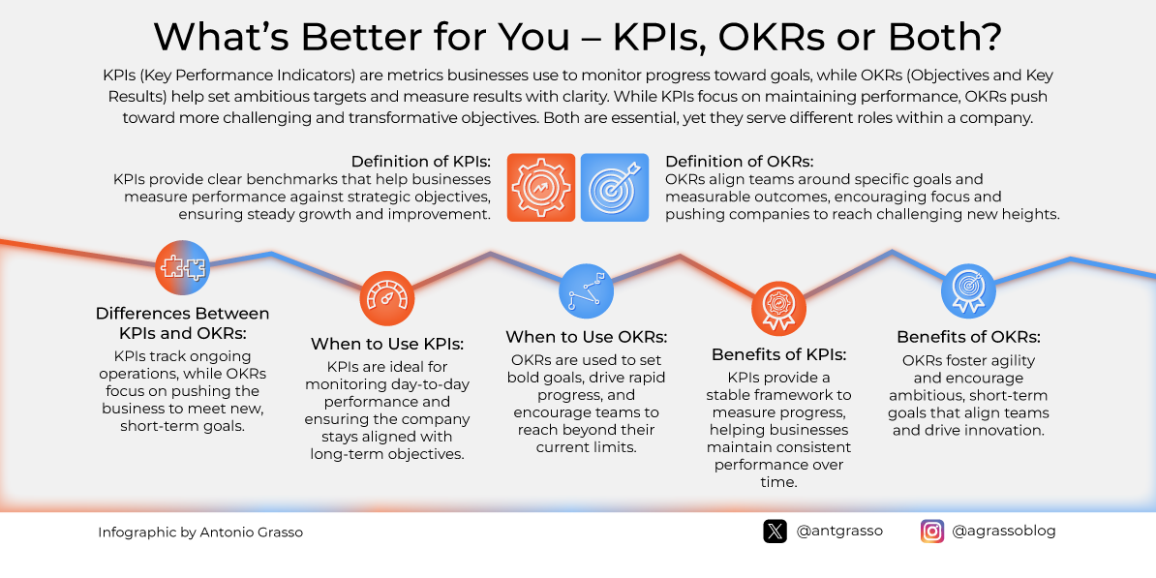

Slide 10
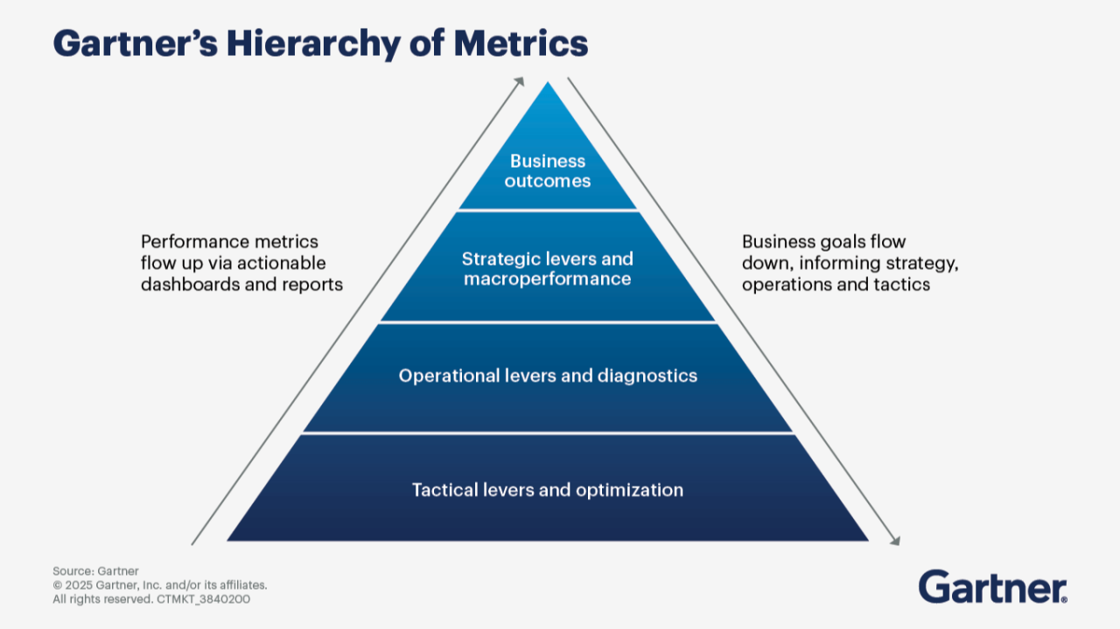
VISUAL HIERARCHY

Slide 11
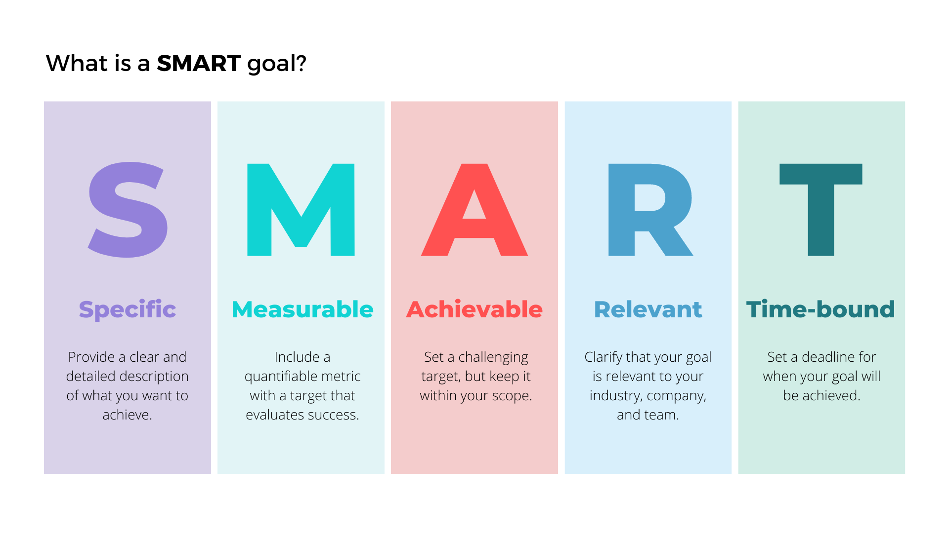
CHARACTERISTICS OF A GOOD KPI
SMART framework:
✔ Specific ✔ Measurable ✔ Achievable ✔ Relevant ✔ Time-bound
Good KPI Example
“Reduce delivery time from 45 min to 30 min in 3 months.”
Bad KPI Example
“Improve customer satisfaction.”

Slide 12
REAL INDUSTRY KPI
🇵🇰 Daraz
Order conversion rate
Delivery success rate
Customer return rate
🇵🇰 Jazz Telecom
Network uptime
Customer churn rate
🌎 Netflix
Watch time
Retention rate
🌎 Google
Click-through rate (CTR)
Ad conversion rate
“Every business tracks different KPIs based on its goals.”

Slide 13
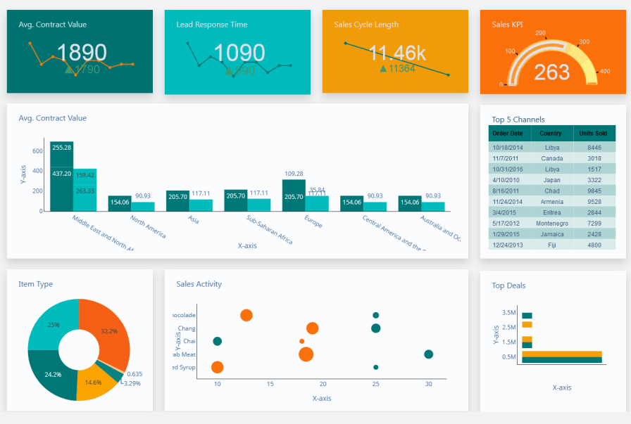
KPI DASHBOARD

Slide 14
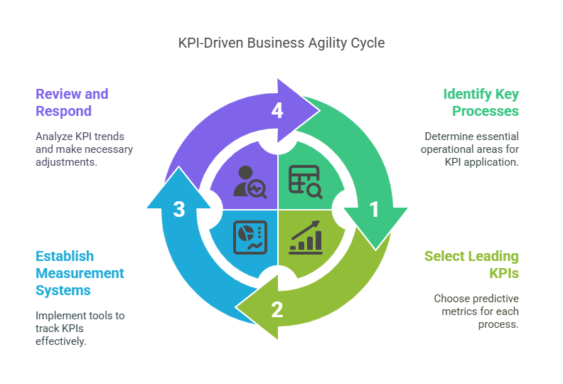
KPI DESIGN FRAMEWORK (STEP-BY-STEP)
Step 1: Identify Business Goal
Example:
Increase revenue.
Step 2: Identify Success Factor
Example:
More customer orders.
Step 3: Define KPI
Example:
Orders per day.
Step 4: Define Target
Example:
Increase from 500 → 700 orders/day.
🎯 Classroom Exercise
Scenario:
Food delivery app.
Students create:
✔ Business goal ✔ KPI ✔ Target

Slide 15
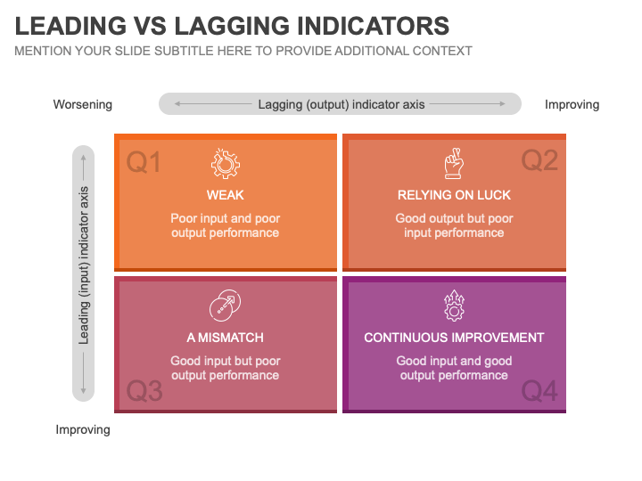
LEADING VS LAGGING KPIS
🟢 Leading KPIs
Metrics used as predictive measure for Future performance.
Example:
Number of new users.
🔴 Lagging KPIs
Metrics used to measure past performance
Example:
Total revenue.
Leading KPIs help prevent problems. Lagging KPIs show results.

Slide 16
CASE STUDY (HIGH ENGAGEMENT)
Scenario:
University LMS.
Students must:
✔ Define 3 KPIs ✔ Classify as strategic/operational ✔ Define targets
Connecting Dots:
Scenario:
QuickBasket wants to grow.
Strategic KPI
Revenue growth.
Operational KPIs
Orders per day
Delivery time
Customer retention
Metrics
App downloads
Page views

Slide 17
COMMON KPIs MISTAKES
❌ Tracking too many KPIs ❌ Measuring irrelevant data ❌ No targets defined ❌ Ignoring business alignment
More KPIs ≠ Better performance.
Focus on what matters.

Slide 18
ROLE OF BUSINESS ANALYST IN KPI DESIGN
BA responsibilities:
✔ Defines KPIs with stakeholders ✔ Ensures alignment with goals ✔ Tracks performance ✔ Communicates insights
Real Scenario
Client says:
“We want better performance.”
BA asks:
👉 “How will we measure it?”
That’s KPI thinking.

Slide 19
IMPORTANT BUSINESS HACK
KPIs = business + data + clarity
BUSINESS GOAL
↓
SUCCESS FACTOR
↓
KPI
↓
TARGET
👉 “Where do most companies fail?”
Answer:
👉 KPI definition stage.

Slide 20
KEY TAKEAWAYS (END OF LECTURE)
✔ KPIs measure business success ✔ Metrics support KPIs ✔ Strategic KPIs = long-term ✔ Operational KPIs = daily performance ✔ Good KPIs must be SMART ✔ BA ensures KPIs align with goals

